Slide 1

ABOUT ME
I’m Thusyanthan Ravichandran, a London-based aspiring data analyst with a Bachelor’s degree in Information Technology and over 9 years’ experience across customer service, logistics, and the gig economy, working with platforms like Deliveroo, Uber Eats, and Just Eat.
Throughout my career, I have developed strong transferable skills such as problem-solving, time management, attention to detail, communication, adaptability, analytical thinking, and self-motivation — all essential qualities for success in data analytics.
I recently completed the Data Technician Bootcamp with Just IT, gaining hands-on experience with Excel, SQL, Python, Tableau, and Power BI. During the bootcamp, I completed real-world projects involving data cleaning, trend identification, and delivering insights through clear, visual storytelling.
Fun fact: Spending time with my little one inspires me to stay inquisitive and observant — qualities every data analyst should have.
I am passionate about continuous learning and dedicated to leveraging data to enhance business performance and optimise operational efficiency. As a data analyst, I focus on collecting, cleaning, and analysing data to identify trends and insights, creating clear reports and visualisations, and supporting data-driven decision-making. My goal is to secure a data analyst role where I can apply my skills to drive impactful outcomes and build a rewarding career.

Slide 2

Marketing Analytics and Sentiment Analysis for an Online Sports Retailer
Overview This project involved an end-to-end data-driven analysis for an online sports retailer experiencing declining customer engagement and conversion rates. I analysed the dataset, including customer feedback, to uncover key trends and insights. By combining marketing analytics with sentiment analysis, I delivered actionable recommendations to optimise marketing strategies, enhance customer experience, and improve overall business performance.
Tech Stack Languages: SQL, Python, DAX Tools & Technologies: SQL Server, Excel, Power BI, Visual Studio Code

Slide 3
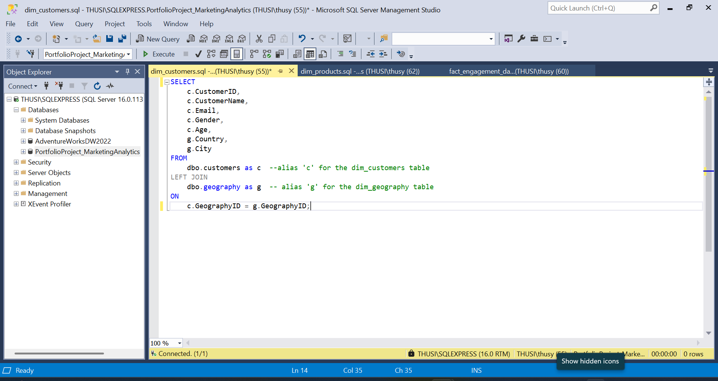
Data Source & Preparation (SQL Server)
Obtained dataset from a public GitHub repository (.bak SQL Server backup)
Restored the database and queried the data using SQL Server
Joined multiple tables to consolidate relevant information
Identified and removed duplicates, null values
Standardised data formats (e.g., date formats, text case, numeric precision)

Slide 4
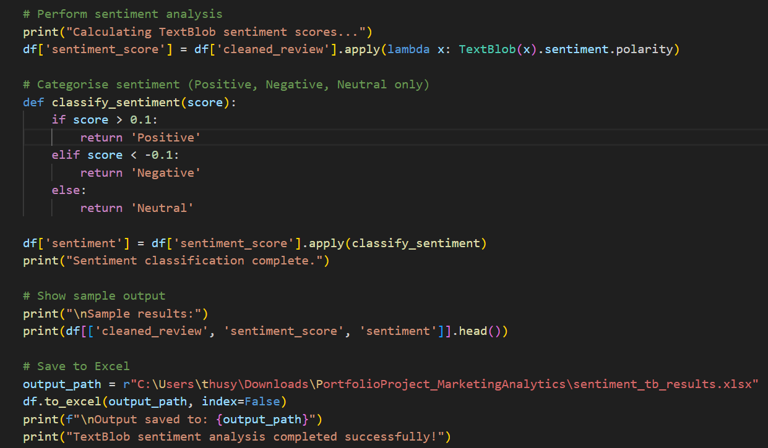
Sentiment Analysis
Analysed customer review text using Python (TextBlob library)
Extracted sentiment insights:
Sentiment Categories: Positive, Negative, Neutral
Sentiment Scores: Calculated using polarity values
Saved processed sentiment data to an Excel (.xlsx) file
Exported sentiment dataset for integration into Power BI

Slide 5
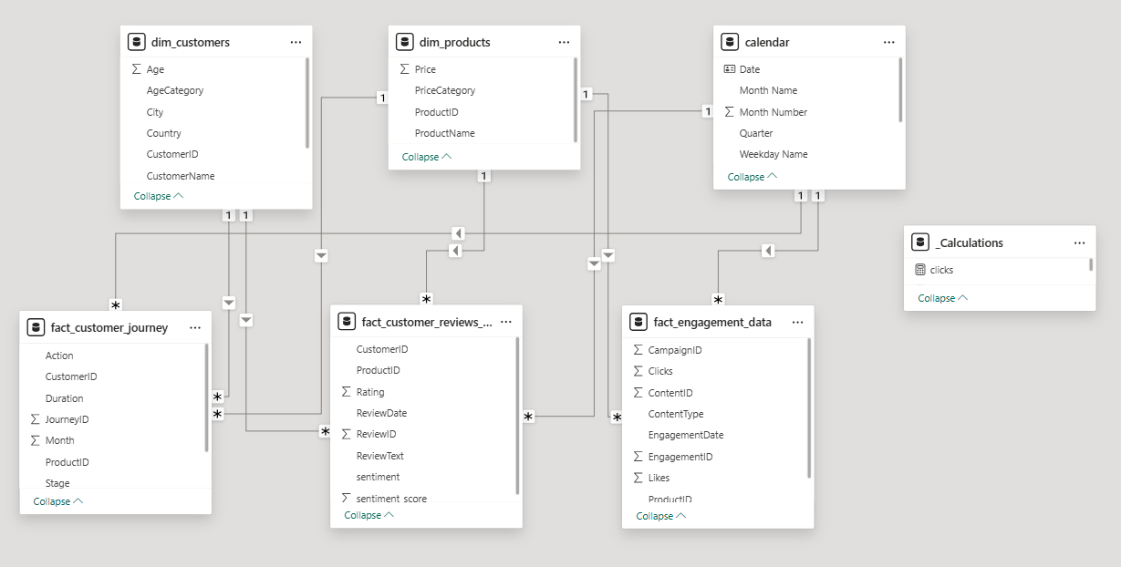
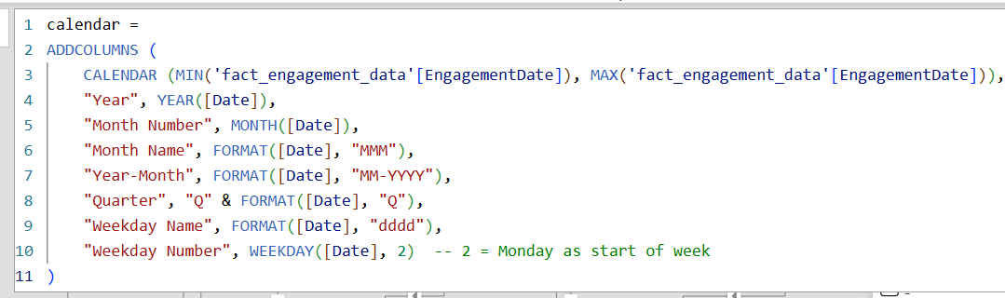
Hybrid Data Cleaning & Modelling in Power Bi
Imported cleaned SQL tables and sentiment results into Power BI
Performed additional data transformation using Power Query for consistency and enhancement
Filled null values with relevant monthly average values to preserve data integrity
Created a custom Calendar Table and marked it as a date table to support time intelligence calculations
Modelled data using a Galaxy Schema (Fact Constellation Schema) with multiple fact and dimension tables
Established relationships to enable efficient, analysis and reporting

Slide 6
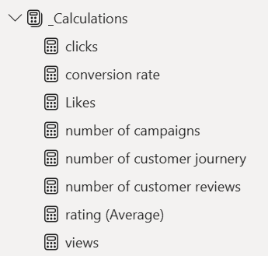
Key Performance Indicators (KPIs)
Conversion Rate: Percentage of visitors who completed a purchase
Sentiment Score: Average polarity of customer review text
Average Rating: Mean rating from product reviews
Total Clicks: Number of product link or ad clicks
Total Views: Number of times products or content were viewed
Total Likes: Number of likes received across social platforms
New measures for these KPIs were calculated using DAX formulas in Power BI

Slide 7
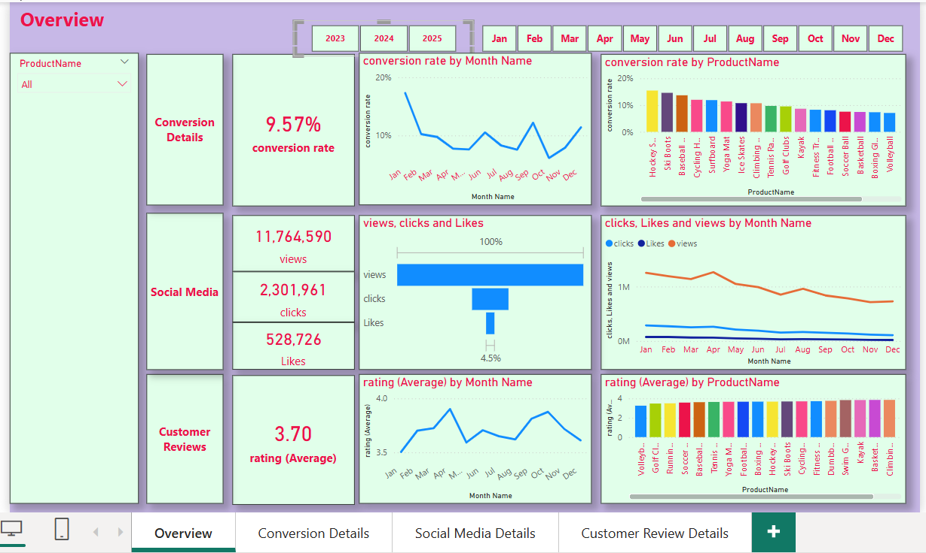
Visualisation & Insights (Power BI)
Built an interactive dashboard featuring multiple tabs:
Overview: Summarises key KPIs at a glance
Social Media Details: Displays monthly views, likes, and clicks
Customer Review Analysis: Tracks sentiment scores and rating trends
Conversion Details: Highlights product performance by conversion rates

Slide 8
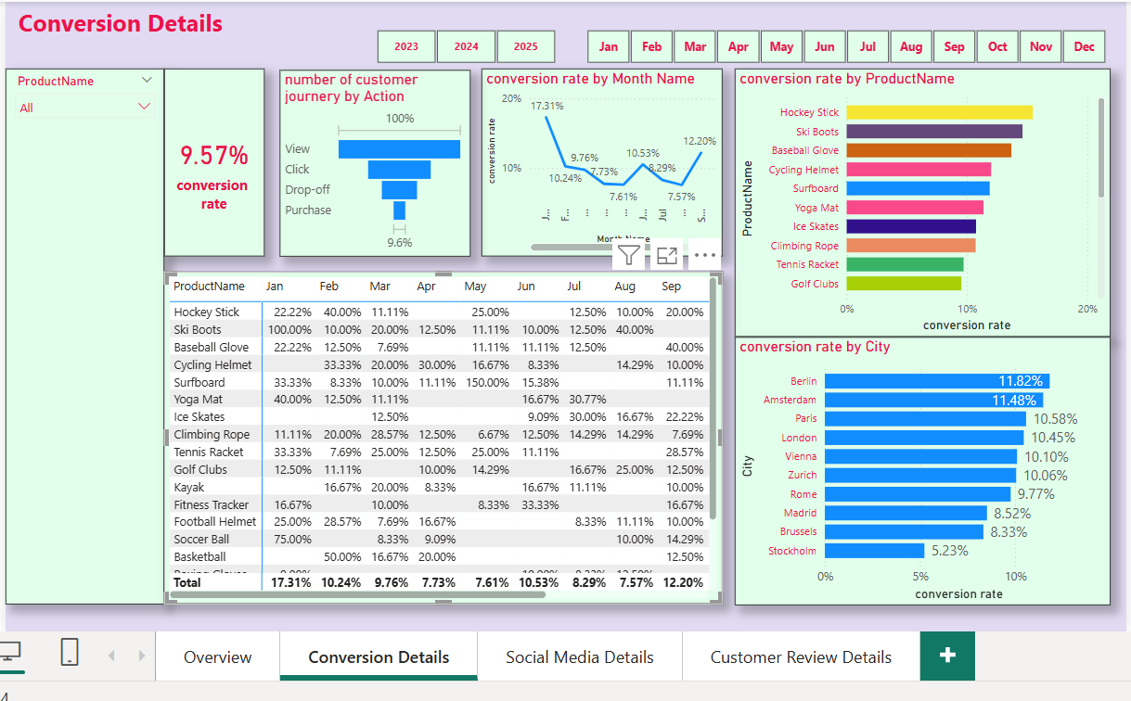
Decreased Conversion Rates
The overall conversion rate fluctuated throughout the year.
A significant drop occurred in October, reaching a low of 5.0%.
A strong recovery followed in December, with the conversion rate rising to 10.2%.
January saw the highest conversion rate at 18.5%, led by the Ski Boots, which achieved an exceptional 150% conversion rate – indicating strong seasonal demand and effective marketing.

Slide 9
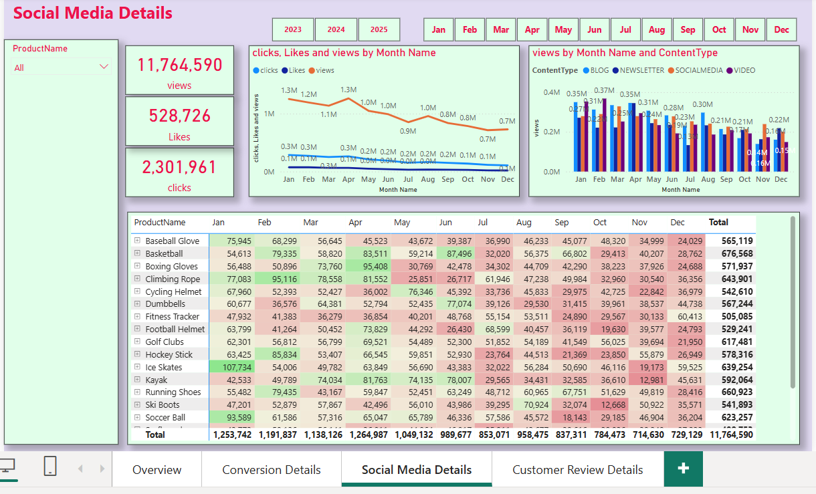
Reduced Customer Engagement
Observed a steady decline in social media engagement over the year
Views peaked in April but consistently declined from May onwards, indicating audience lost interest over time
Clicks and likes remained relatively low compared to views
Despite this, the click-through rate (CTR) stayed strong at 15.37%, showing that engaged users continued to interact actively.

Slide 10

Customer Feedback Analysis
Average customer rating remained stable at 3.7, below the target of 4.0
Products rated below 3.5 should be prioritised for quality or service improvements
Sentiment analysis revealed a mix of positive, neutral, and negative feedback
Highlights the importance of addressing key customer pain points to improve satisfaction

Slide 11













THANK YOU
Let’s Connect
I'm open to collaboration, feedback, and new opportunities.
You can find me or explore more of my work through:
https://www.linkedin.com/in/rthusy/
https://github.com/Thusyanthan-R
https://www.thusyanthan.dev

Slide 12
